Slide 1
KCICN LEVEL OF CARE System Module 1: clinical staff and Supervisor training
King County Behavioral Health and Recovery Division/
King County Integrated Care Network (KCICN)
Behavioral Health and Recovery Division
Department of
Community and Human Services

Slide 2
learning objectives
This training will focus on the provider-level considerations and what changes a clinician/provider may experience in the new KCICN payment system
Review of past tier system
Why this change is happening
Overview of new system
Clinician responsibilities in the new system

Slide 3
disclaimer
This is a basic overview of the King County Integrated Care Network’s (KCICN) new level of care and payment system – your agency may still have additional requirements.
Follow your agency’s guidance!

Slide 4
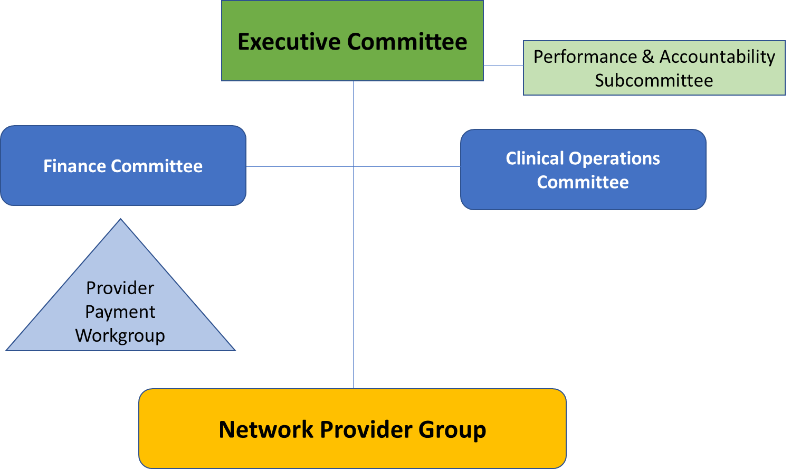
What is the kcicn?
Since 2019, King County and agencies have had a partnership - the King County Integrated Care Network (KCICN)
The new Level of Care model went through a reiterative process through all KCICN governing committees

Slide 5
Mental Health and sud
Delayed implementation for new SUD payment system until Q4 2020

Slide 6
A word about terminology
We are moving away from using the term “Tier” towards “Level of Care”
Tiered → Enrolled client or open benefit
Tier level → Level of Care
2X, 3A, 3B → ~ Low, Medium, High
Retier

Slide 7
Past “Tier” System
Agency assigns level of care (the “Tier”)
By diagnosis and LOCUS/CALOCUS only
Tier Levels: 2X, 3A, 3B
Benefit termination end date
Scheduled annual increments for retier
Paid as Case Rates: Set payment per client each month, regardless of the number of services provided

Slide 8
Why change? SYSTEMIC CHANGES TO REFLECT CARE
The new Level of Care system is designed to reflect the many pieces you’re already bringing into your work:
Focused on the whole person
Services that are varied and tailored to client’s individual need
Prioritizing the connection between behavioral health and physical health
Prioritizing care coordination across all service providers, and all systems
Striving for recovery-oriented outcomes and long-term wellness

Slide 9
Why change? improvements
More consistency in assigning clients to the appropriate level of care
Greater access to data elements
Allows for more timely and accurate adjustments to levels of care

Slide 10
What is the new level of care system?

Slide 11
New levels of care
Level of Care determined by LOCUS/CALOCUS (agency) and other clinical risk factors (data driven)
Population Health Stratification Model
Service intensity expectations and payment depend on assigned level of care:
Low
Medium
High

Slide 12
Population health stratification (PHS) model
Population Health Stratification Model uses data on:
Acute Care Utilization
Social Determinants of Health
Chronic Conditions
Clinical Assessments (LOCUS/CALOCUS)
MENTAL HEALTH LEVELS OF CARE
Low | 0-4 total points
Medium | 5-10 total points
High | 11+ total points

Slide 13
PHS MODEL – ADULT MENTAL HEALTH
Acute care utilization
Hospitalization or ED visits, SUD withdrawal management, ITA, SUD residential (all causes) in last 12 months | 0 = 0 points 1-2 = 1 point 3-5 = 5 points 6+ = 11 points
Social determinants of health
Housing stability | Stable housing = 0 points Homeless = 7 points
Jail utilization (all types of incarceration) volume | None in last 6 months = 0 points 1-2 incarcerations in last 6 months = 2 points 3+ incarcerations in last 6 months = 3
Jail length of stay | Any one incarceration >2 consecutive years in last 5 years = 1 point
Chronic conditions
Presence of diabetes, cardiovascular disease, asthma, or COPD | None of these conditions = 0 points 1 of these conditions = 2 points 2+ conditions = 3 points
Assessments
LOCUS | 13 and below = 1 point 14-16 = 4 points 17+ = 8 points

Slide 14
PHS MODEL – CHILD/YOUTH MENTAL HEALTH
Acute care utilization
Hospitalization or ED visits, SUD withdrawal management, ITA, SUD residential (all causes) in last 12 months | 0 = 0 points 1-2 = 5 points 3-5 = 11 points
Social determinants of health
Foster care | No history of foster care = 0 points History or current foster care = 3 points
Chronic conditions
Presence of diabetes, cardiovascular disease, asthma, or COPD | None of these conditions = 0 points 1 of these conditions = 2 points 2+ conditions = 3 points
Assessments
CALOCUS | 13 and below = 1 point 14-16 = 5 points 17+ = 11 points

Slide 15
PHS Data agencies are responsible for:
Adult
Housing data
LOCUS
Chronic conditions (Conditions at Assessment) – optional
Child/Youth
Foster Care (Housing Data)
CALOCUS
Chronic conditions (Conditions at Assessment) – optional

Slide 16
When Level of care is assigned
Level of Care is assigned at intake (within 5 business days of all data information being submitted).
The PHS is rerun every quarter, so there is the possibility the level of care could change.

Slide 17
What are my responsibilities in the new system?

Slide 18
How level of care will impact your services
Past Tier Model: paid on Case Rates
In many other part of the State, Behavioral Health now is paid as Fee for Service – only get paid for the Medicaid encounterable services you provide.
New Level of Care System: will pay a case rate based on Level of Care that is adjusted based on actual utilization hours (hours of Medicaid encounterable services you provide).
Your services impact payment!

Slide 19
Utilization hours
Expected utilization hours are determined by assigned level of care.
Services prescribed in Individual Service Plan (ISP) should align with level of care.
LEVEL OF CARE (ADULT/PEDS) | UTILIZATION HOURS/MONTH
High | 7.0 (prev. 7.5)
Medium | 2.5 (matches previous)
Low | 1.5 (prev. 1.25)

Slide 20
Utilization hours AND PAYMENT
Why do utilization hours matter?
Payment will be based on actual vs. expected hours (Service Delivery Adherence or SDA)
SERVICE DELIVERY ADHERENCE | PAYMENT
Expected service hours | Full payment for level of care
Fewer than expected service hours | Decreased payment
No services | Grace period of decreased payment before payment ends

Slide 21
How do I meet SDA Expectations?
Verify level of care so you know the target.
Review ISP for appropriate interventions so not over serving or under serving.
Review plan with individual.
All service types are weighted the same towards
utilization hours (all SERI codes count the same)

Slide 22
How do I meet SDA Expectations?
Potential interventions for providing whole person care:
Care Coordination with family, health care providers, other service providers (housing, employment, DSHS, school, DOC)
Individual and Family Therapy, Psychoeducation and Therapy Groups, Case Management Services
Peer services
Crisis Prevention and Crisis Response

Slide 23
Matching sda expectations to the Isp
What if I’m working on the ISP and think the assigned level of care and SDA expectations are…
Too High?
What makes their population health stratification points so high?
Understand the report that identifies why the client is assessing so high.
What identified need am I missing?
Too Low?
Are the services I am providing medically necessary?
Am I potentially overserving a client who doesn’t need it?
Would referrals to other services be helpful?

Slide 24
Outreach and engagement
Will be important to maintain contact and maintain client’s level of service
Letters and phone calls
Outreach to home and community
Have ROIs signed for collateral contacts and natural supports – Primary Care Doctor, Probation Officer, friends and family
If someone isn’t engaging – why?
Can we do more effective outreach?
Is the ISP meeting their needs and goals?
Do they still meet medical necessity? (Talk to your supervisor)

Slide 25
Updating client information
ISP should be updated whenever there is:
A significant life change
A new presenting issue arises
Goal updates (goal is resolved, or changes)
Intervention changes
A change to the assigned Level of Care, this can change quarterly
Level of Care data should also be updated whenever there are changes
Slightly different guidelines for Medicaid and MIDD (Non-Medicaid) benefits
Remember, PHS is run quarterly – client’s Level of Care will be more accurate if your information is up to date!

Slide 26
Updating level of care data: medicaid
Open-ended benefit period – no more annual retier!
However agencies are responsible for updating the following at least within the “Anniversary Window” (2 months prior and after original benefit date anniversary) to support Medical Necessity:
LOCUS/CALOCUS
Diagnosis
Residential arrangement - Housing status for adults/foster care status for youth
Conditions at assessment – optional for Chronic Conditions data
A service encounter

Slide 27
Updating level of care data: MIDD
Annual benefit period will continue only for MIDD benefits
Agencies will need to request a new MIDD benefit every year as they do now or request to change to a Medicaid benefit, if applicable
Within 30 days of the original benefit date anniversary:
Authorization request
LOCUS/CALOCUS
Diagnosis
Residential arrangement - Housing status for adults/foster care status for youth
Income category & Medicaid coverage - To determine continued eligibility for MIDD benefit
Conditions at Assessment – optional, but important to add for Chronic Conditions data for MIDD benefits
A face-to-face service encounter and a re-assessment summary

Slide 28
Updating level of care data
Why do I need to keep the information up to date?
Match level of care with the client needs that you’re seeing
Ensures documentation continues to support medical necessity (Medicaid requirement!)
More up to date information should drive better more informed clinical care.
Keeps the Progress Notes, ISP, and Assessment aligned (Medicaid requirement!)

Slide 29
Wrap up: old vs. new
Individual Service Plan
Progress Notes
Individual Service Plan Updates
Behavioral Health Assessment
Assessment/Intake: An intake appointment is still required to enroll an individual into services. Medical necessity is established at the time of the initial assessment (WAC 246-341-0610).
LOCUS/CALOCUS: This remains a requirement to be completed and will be conducted at the time of initial assessment/intake.
Can be done as often as needed, whenever things change.
At a minimum needs to be done annually within the anniversary window
Level of care: The intake specialist will no longer request a tier level. The level of care will be assigned based on the Population Health Stratification Model.
Other data elements will be factored in to determine level of care

Slide 30
Wrap up: old vs. new
Individual Service Plan
Progress Notes
Individual Service Plan Updates
Behavioral Health Assessment
Individual Service Plan (ISP): The initial ISP should be started at the 1st appointment following the assessment/intake. Thereafter, ISPs must be updated as changes occur – it’s a living document (WAC 246-341-0620).

Slide 31
Wrap up: old vs. new
Individual Service Plan
Progress Notes
Individual Service Plan Updates
Behavioral Health Assessment
Progress notes: Even more important to document your services as they occur, keeping connection to the Golden Thread (ISP and LOCUS/CALOCUS).
Justify that services continue to meet medical necessity
Service utilization is based on submission of finalized encounters

Slide 32
Wrap up: old vs. new
Individual Service Plan
Progress Notes
Individual Service Plan Updates
Behavioral Health Assessment
ISP Updates reflect changes to client needs as they occur and keep a continuous connection to progress notes.
No concurrent reviews required
Updates/reviews not required on certain timelines except for MAT
Annual retiers: no longer exist for Medicaid.
However:
LOCUS/CALOCUS, diagnosis, and other data elements must be done whenever they change - at least within the anniversary window.
Progress Notes and ISP should continue to justify medical necessity.

Slide 33
Onboarding academy
Onboarding Academy is currently revising these trainings to align with the New Level of Care Model:
Medical Necessity & Assessments
Individual Service Plans
Progress Notes
Care Coordination
Case Management

Slide 34
Questions?
Behavioral Health and Recovery Division
Department of
Community and Human Services

Slide 35
Contact Information
Lindsay Lopes: llopes@kingcounty.gov
Jamie Lee: Jamie.lee@kingcounty.gov
Charlotte Lefler: clefler@kingcounty.gov
Audrey Ouellette: aouellette@kingcounty.gov
Anna Cesa: acesa@kingcounty.gov
Behavioral Health and Recovery Division
Department of
Community and Human Services

